Slide 1
Data Visualization & Interpretation
Febin.A.Vahab

Slide 2
SESSION 4 -PLAN
Visualisation Design concepts -T1 CH 5

Slide 3

Design Concepts
Traditional Design Concepts
Affordances
Accessibility
Aesthetics
Acceptance

Slide 4
Form Follows Function
Function
Think about what our audience be able to do with data
Form
Create a visualization

Slide 5
Affordances
“A situation where an object’s sensory characteristics intuitively imply its functionality and use”
-- Crowdcube

Slide 6

Affordances
Affordances
Inherent usability aspect in the product
How to interact with or operate the product?
With sufficient presence of affordance, good design fades into background
Example, teapot has a handle, door has a handle

Slide 7

Affordances
Lessons
Highlight the important stuff
Eliminate distractions
Create clear hierarchy of information

Slide 8
Affordances
Highlighting
Focus on a fraction of overall visual (10% highlighting)
Guidelines
Bold, italics, underlining :
Use for titles, labels, captions and short word sequences
Bolding preferred as it adds little noise
Use underlining sparingly as it add lot of noise
Case, typeface :
for short word sequences use uppercase
Can be used for titles, labels, keywords
Avoid different fonts as it disrupts aesthetics

Slide 9
Affordances
Highlighting
Guidelines
Color :
Effective highlighting technique
Use sparingly
Size :
Way to attract attention
Signals relative importance
Blinking / Flashing:
Avoid or
Use only to indicate highly critical information that requires immediate response

Slide 10
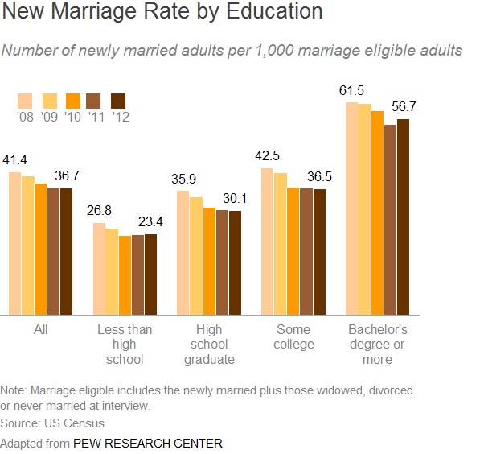
Affordances
Highlighting (example)
“New census data show more Americans are tying the knot, but mostly it’s the college educated.”

Slide 11
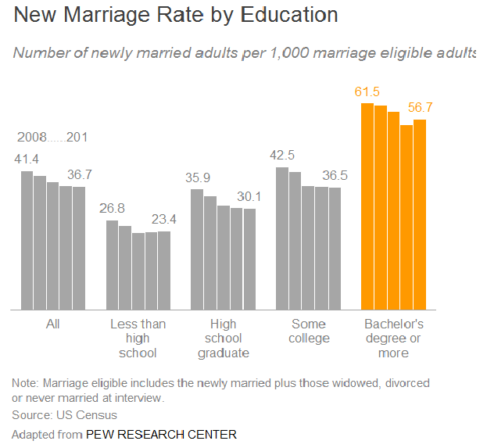
Affordances
Highlighting (example)
Changing the use of color completely redirect the focus

Slide 12
Affordances
Eliminate Distractions
“You know you have achieved perfection, not when have nothing to add, but when you have nothing to take away.”
--Antoine de Saint-Exupery,
Airman’s Odyssey
… what to cut or de-emphasize can be more important than what to include

Slide 13
Affordances
Eliminate Distractions
Focus on clutter and context
Considerations
Not all data are equally important
When detail is not needed, summarize
Ask: would eliminating this change anything?
Push necessary, but non-message conveying items to background

Slide 14
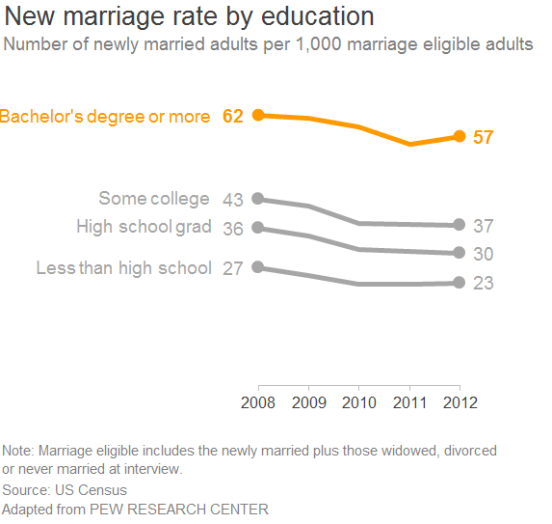
Affordances
Eliminate Distractions (example)

Slide 15
Affordances
Eliminate Distractions (example)
What’s improved?
Change from bar to line
Reduced bars from 25 to 4 lines
Same x –axis instead of legends
“All” category removed
Decimal points rounded to whole digits
Italics in font changed in subtitle
Highlighting of “Bachelors degree or more” category

Slide 16
Affordances
Visual Hierarchy of information
Preattentive attributes can be used for focusing
Pull some item foreground, push some items to background indicating the order in which to process the information

Slide 17
Affordances
Visual Information Hierarchy (example)
Car manufacturer
Dimensions used for determining success of make and model
Customer satisfaction
Frequency of car issues

Slide 18
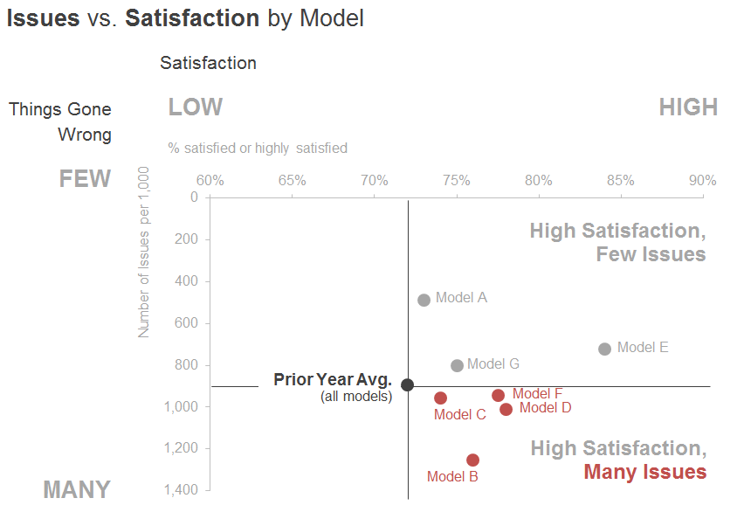
Affordances
Visual Information Hierarchy (example)

Slide 19
Affordances
Visual Information Hierarchy (example)
Hierarchy components
Graph title: Bolding of words used
y-axis label: Issues scale visible
x-axis label: Satisfaction scale visible
Dark point in visual: Last years average
Red points in last quadrant: highlighting used

Slide 20
Accessibility
Accessibility
Designs should be usable by people of diverse abilities
Example, mobile phone screens
Work to make your data visualizations similarly straightforward and easy to use

Slide 21
Accessibility
Accessibility strategies
Don't overcomplicate
Use text to label, introduce, explain, reinforce, highlight, recommend, and tell a story

Slide 22
Accessibility
Don’t overcomplicate
“If it’s hard to read, it’s hard to do it.”
“The more complicated the visual looks, the more time audience perceives it will take to understand and less likely they are to spend time to understand it.”
-- Cole Knaflic

Slide 23
Accessibility
Don’t overcomplicate
Guidelines
Make it legible
use consistent, easy to read font
Keep it clean
use visual affordance, remove clutter
Use straightforward language
over complex one
Remove unnecessary complexity

Slide 24
Accessibility
Text is your Friend
Accessible visual
Use text to label, introduce, explain, reinforce, highlight, recommend, and tell a story
Must have text for chart titles, axis titles
Use text for conclusion or suggestion or recommended action

Slide 25
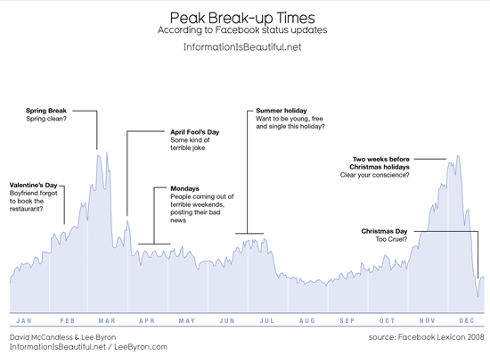
Accessibility
Text is your friend (example: annotations)

Slide 26
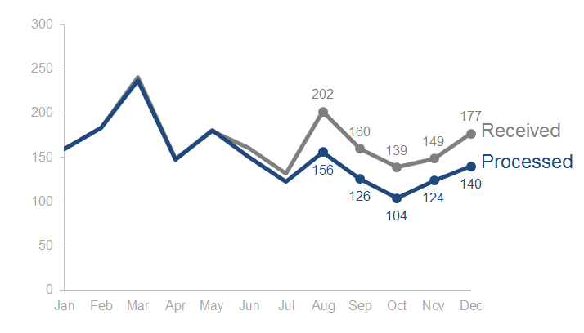
Accessibility
Text is your friend (example)

Slide 27
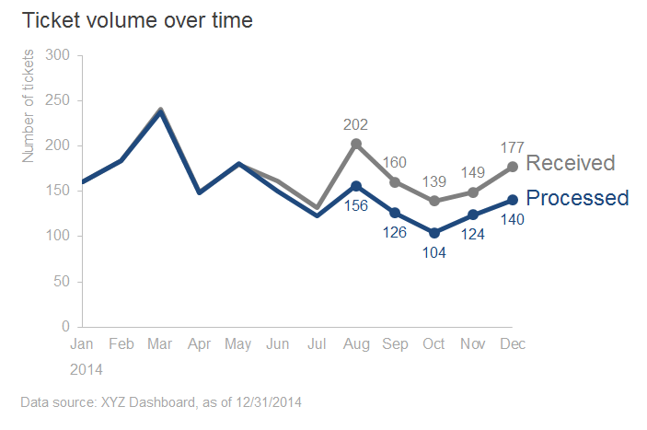
Accessibility
Text is your friend (example)

Slide 28
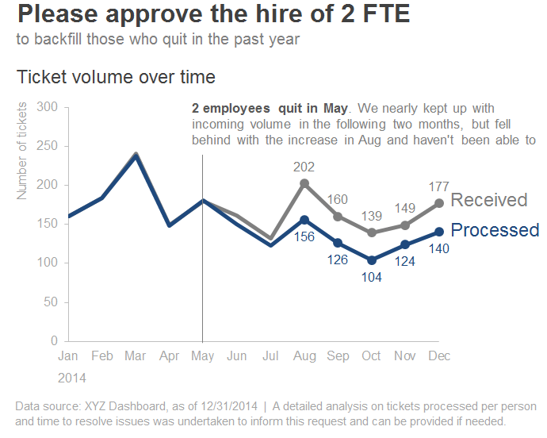
Accessibility
Text is your friend (example)

Slide 29
Aesthetics
“People perceive more aesthetic designs as easier to use than less aesthetics designs – whether they actually are or not.”
- Cole, Storytelling with data
…. Increases our chance of success for getting our message across

Slide 30
Aesthetics
Considerations
Be smart with color
Use it sparingly and strategically
Pay attention to alignment
Create sense of unity and cohesion
Leverage white space
Preserve margins
Don’t stretch graphics or add things

Slide 31
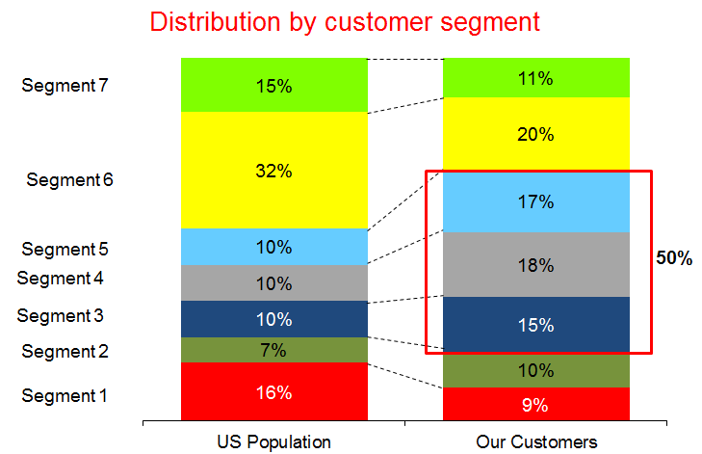
Aesthetics
Aesthetics (example)

Slide 32
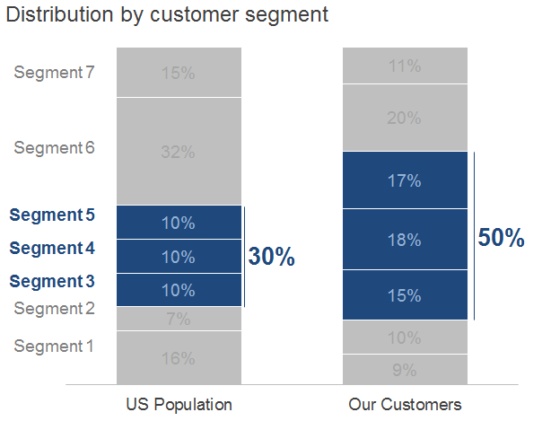
Aesthetics
Aesthetics (example : improved)

Slide 33

Acceptance
“For a design to be effective, it must be accepted by its intended audience.”

Slide 34

Acceptance
Strategies for gaining acceptance
Articulate the benefits of the new or different approach
Show the side-by-side
Provide multiple options and seek input
Get a vocal member of your audience on board

Slide 35
Thank You!

